Slide 1


ACM MobiSys 2018
Munich, Germany
Cross-Platform Support for Rapid Development of Mobile Acoustic Sensing Applications
Presenter: Gaoyang Guan
Yu-Chih Tung, Duc Bui, Kang G. Shin
The University of Michigan
Notes:
Good morning.
I am Gaoyang Guan from Zhejiang University.
Today I am going to talk about “Accelerating Mobile Applications at the Network Edge with Software-Programmable FPGAs”.

Slide 2
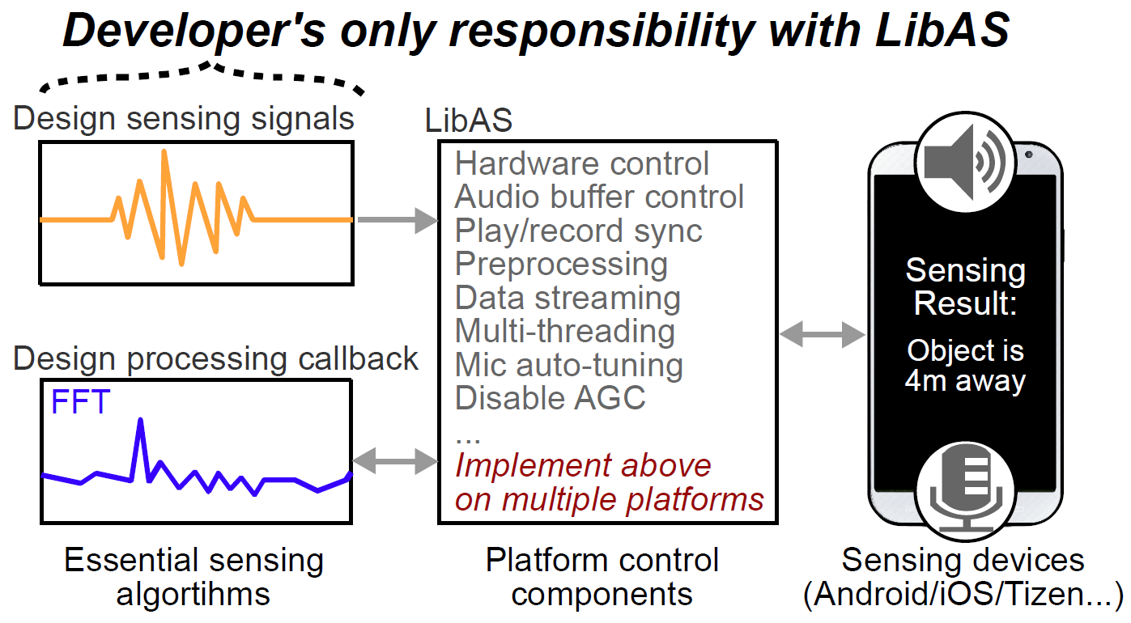
Developing Acoustic Sensing Apps
Cross-platform implementation and deployment of acoustic sensing apps require a significant amount of time and effort;
Large amounts of time and effort are spent repeatedly to address common platform issues that are irrelevant to sensing.

Slide 3
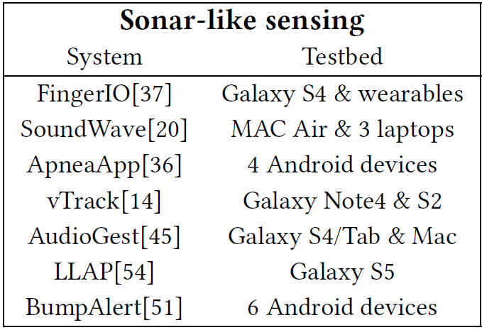
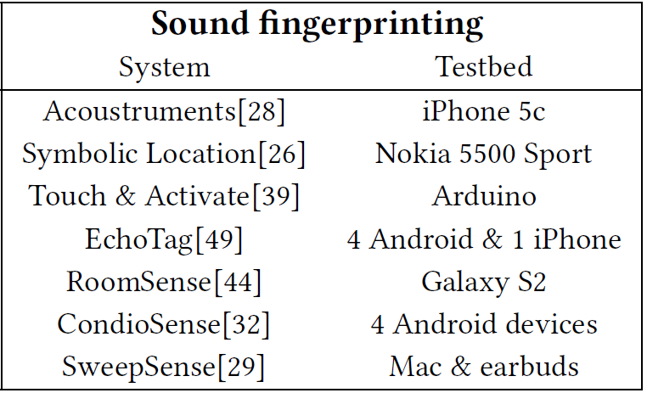
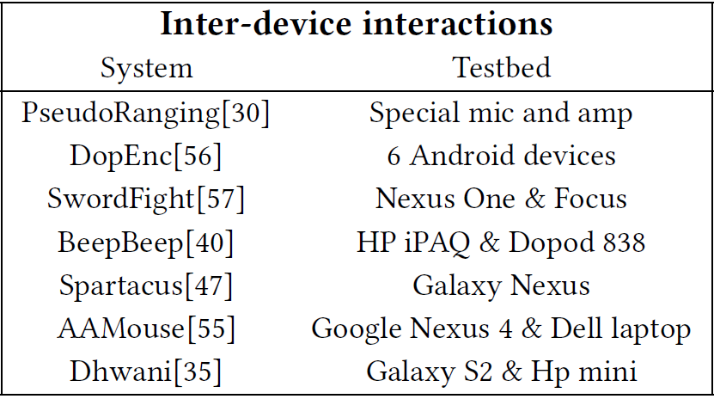
Acoustic Sensing Apps
Most acoustic sensing apps are only implemented
and tested on few devices and platforms.

Slide 4
Motivation
Personal Assistant
Developers are only required to choose signals to sense and then build a callback function for handling;
Divide a normal acoustic sensing app into two parts:
(1) sensing algorithms; (2) platform control components.

Slide 5
Contributions
Design of the first library to ease the cross-platform development of acoustic sensing apps;
Implementation of three existing apps from different categories using LibAS;
Evaluation of the overhead of LibAS and capability to handle the effects of heterogeneous hardware/platform support;
User study of three developers who used LibAS in their real-world projects.

Slide 6
Challenges
Fragmented programming language support
JavaScript on Android
Objective-C/SWIFT on iOS
C/C++ on Linux/Win
Platform settings
Detailed knowledge to set different platforms correctly
E.g., multiple flags (AudioSource.VOICE_RECOGNITION) to disable AGC on Android, AVAudioSession flag on iOS
Device hardware tuning
Some microphones receive 20db signal strength at 22kHz
Locations of microphone/speaker affects the signal strength

Slide 7
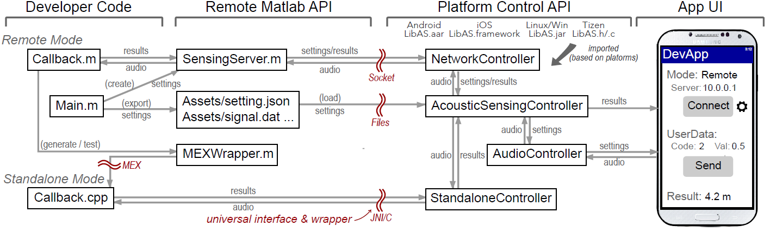
System Overview
Remote Server
Sensing Device
Sensing
Algorithms
App
Config.
Platform
Control
UI

Slide 8
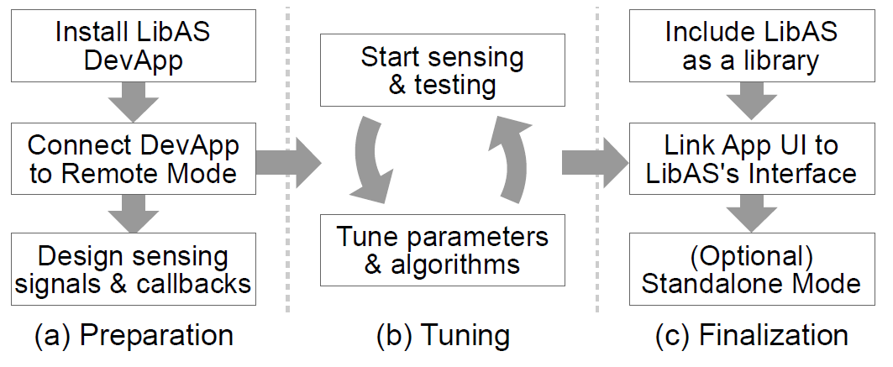
Development Flow
Design of the first library to ease the cross-platform
Matlab Script
Matlab Coder API
Transformed C Library
Remote
Mode
Standalone
Mode

Slide 9
Development Flow
Sensing Data
Design of the first library to ease the cross-platform
Matlab Script
Matlab
MEX
Transformed C Library
However, it is challenging to develop/debug the transformed C library due to the lack of proper signal processing and visualization support.
LibAS provides a MexWrapper that can easily connect/test the C library even in the remote mode.

Slide 10
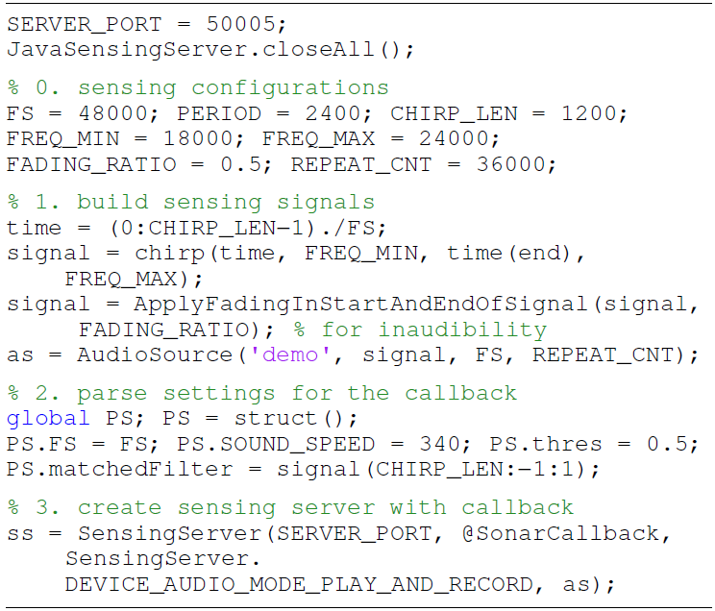
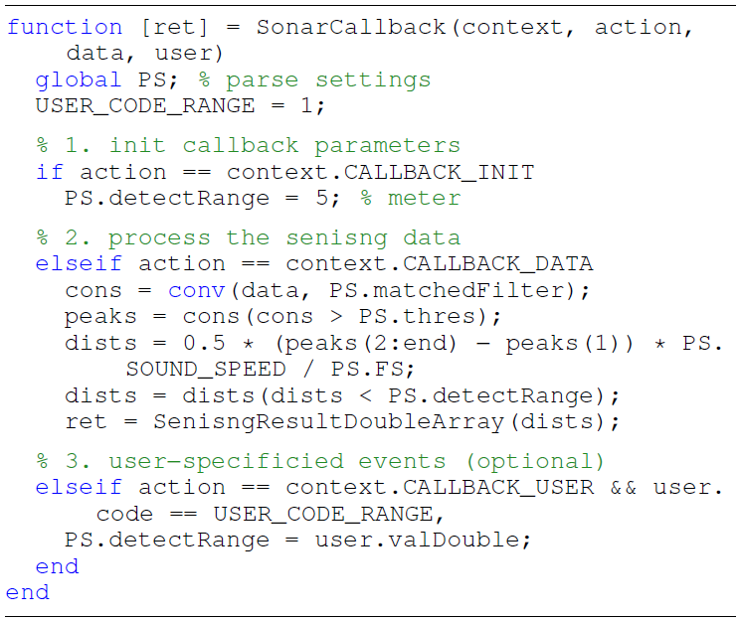
Demo – Sonar Sensing
Config
Sensing
algorithms
Signal
Settings

Slide 11

Demo - Inter-Device Movement Sensing
Controlling multiple devices to sense simultaneously

Slide 12
Demo - GUI for Activity Fingerprinting
Realize similar fingerprinting apps without writing any code

Slide 13
Experimental Setup
Sensing Server - 2013 MacBook Air
1.3 GHz CPU
8GB RAM
Sensing Device
iPhone 5c/6s
Android Nexus 6P
Galaxy S4/S5
Zenwatch 3
Tizen Gear S3
WiFi
802.11n WiFi router
Notes:
the average RTT to their optimal Amazon EC2 instance is 74 ms

Slide 14
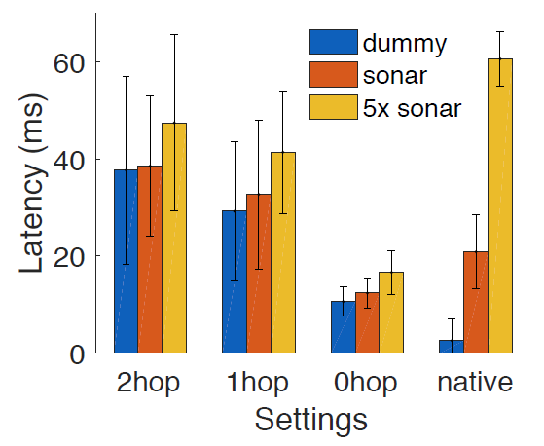
Evaluation Results
Overhead
Dummy
Null message
0-hop 10ms
6ms Java socket
4ms processing
Sonar
Sonar Sensing App
5x Sonar
Benefit from
offloading
10ms
Notes:
2.9x shorter than the cloud offloading case because of the shorter RTT, even with a delay of 0 ms

Slide 15
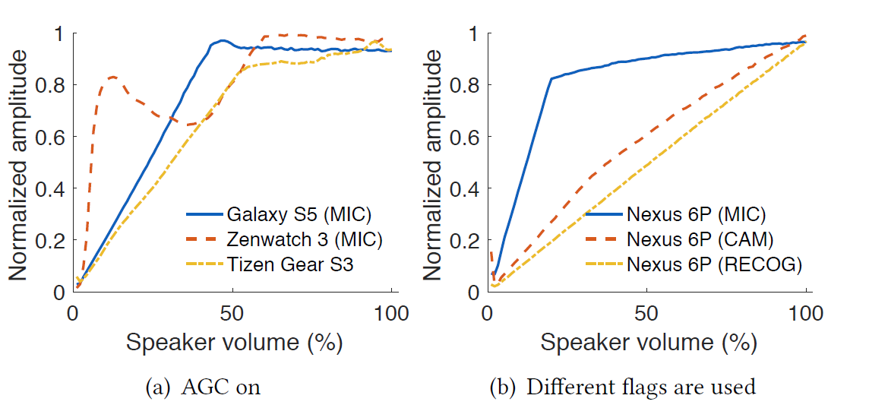
Evaluation Results
Adaptability
Platform heterogeneity
Automatic gain control (AGC) detections
Notes:
2.9x shorter than the cloud offloading case because of the shorter RTT, even with a delay of 0 ms

Slide 16
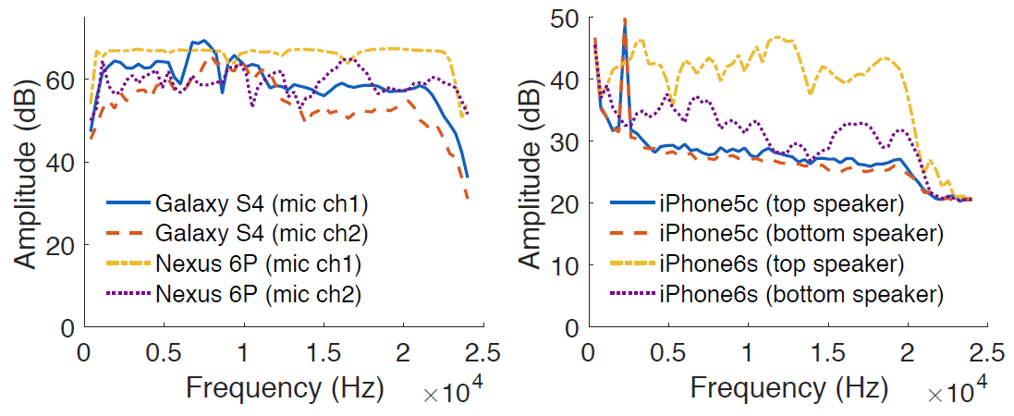
Evaluation Results
Adaptability
Device heterogeneity
22kHz
This hardware heterogeneity calls for a careful design of sensing signals and algorithms
Notes:
2.9x shorter than the cloud offloading case because of the shorter RTT, even with a delay of 0 ms

Slide 17
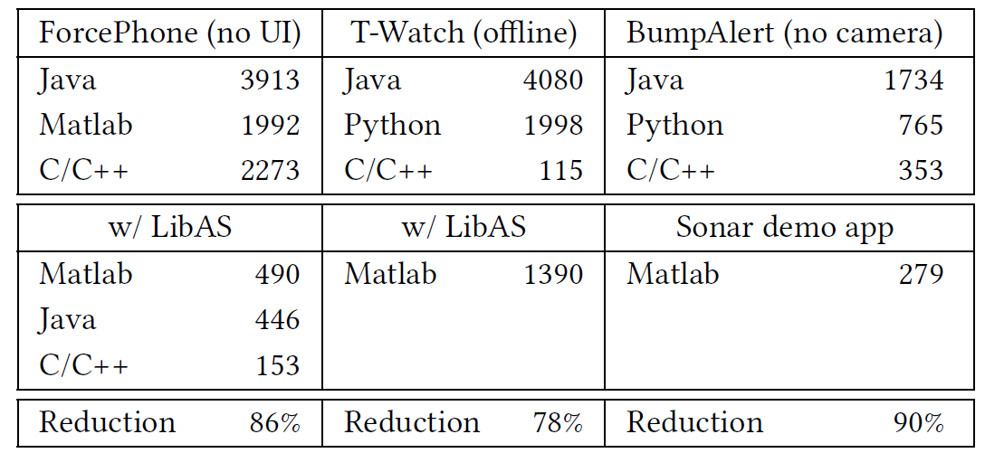
User Experience
Users
Engineer A@a major smartphone manufacturer, 200M/y
Student B and C are CS PhD students
Benefits of Using LibAS
The visualization provided by LibAS’s remote mode
LibAS’s abstraction helped them focus on developing the core sensing algorithm
Code reduction
Notes:
Help them “see” and understand how the received response changed (e.g., a higher/lower SNR)

Slide 18
Compared with TinyLink
Same
High level abstraction
Interpret into different implementations
Easy to extent more libraries
Diff
Focus on domain knowledge of acoustic libraries
Mobile app development, no hardware selection
Standalone & server mode, using offloading tech
Inspiration
User experience study
UI helps developing and debugging
Debug and release based on remote cross-language tech

Slide 19
Rapid Development or Offloading?
Offloader
Request Device
Proxy
Matlab Script
Proxy
Controller
Transformed C++ library

Slide 20
Q&A

